Slide 1
Using REDCap
To Help Support REDCap
Sue Lowry
Biostatistical Design and Analysis Center (BDAC)
Clinical and Translational Science Institute
Academic Health Center
University of Minnesota

Slide 2
Ways I use REDCap to help support REDCap
REDCap Demonstration Attendees project
REDCap Demonstration Registrations project
Request for new non-LDAP REDCap user project
Links to other pages from the REDCap Home tab

Slide 3
REDCap Demonstration Attendees project
Allows me to keep track of who has attended a REDCap demonstration
When we went from on-request demos to scheduled demos, I was able to look at this data to see what day of the week and time seemed to work best

Slide 4
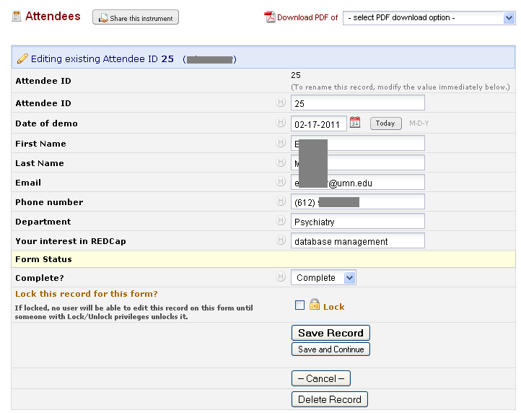

Slide 5
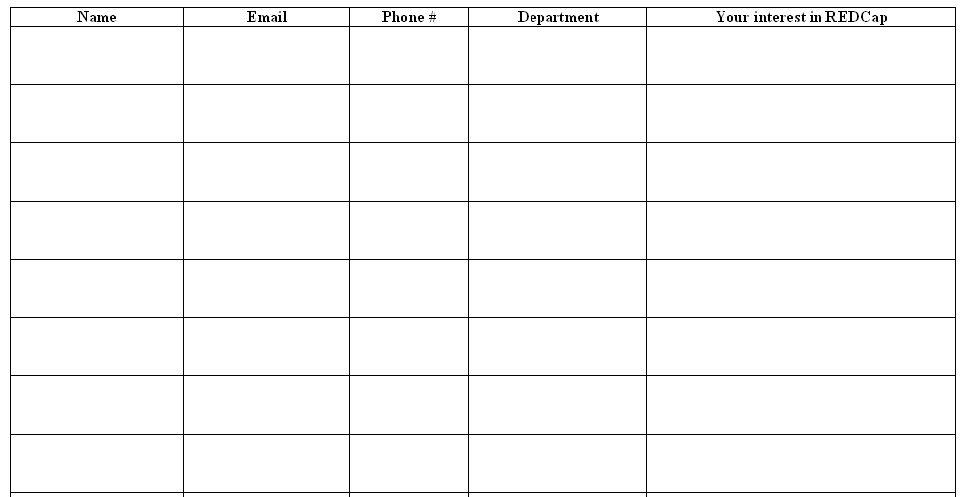

Slide 6

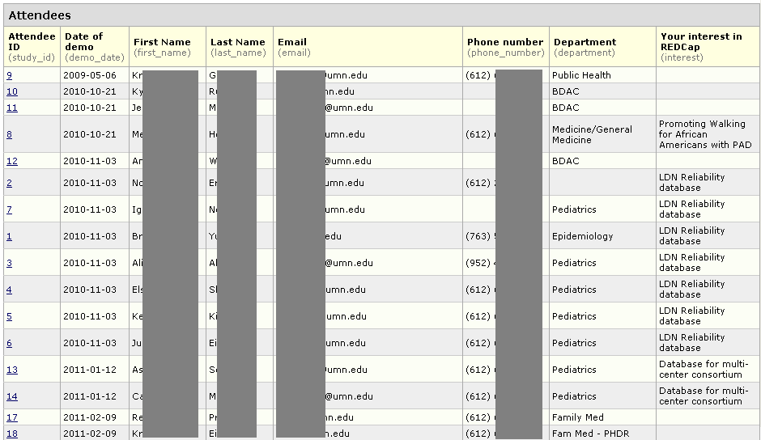

Slide 7
REDCap Demonstration Registrations project
Started using last December, when we switched from on-request demos to scheduled demos
Allows people to register for a scheduled REDCap demonstration or request a special, unscheduled demonstration

Slide 8
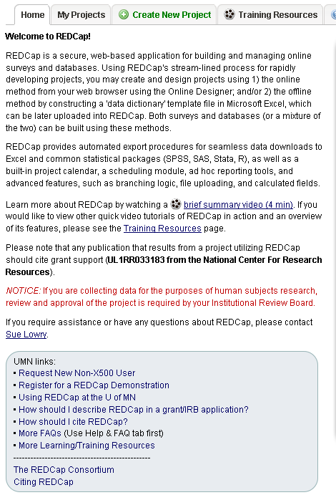


Slide 9
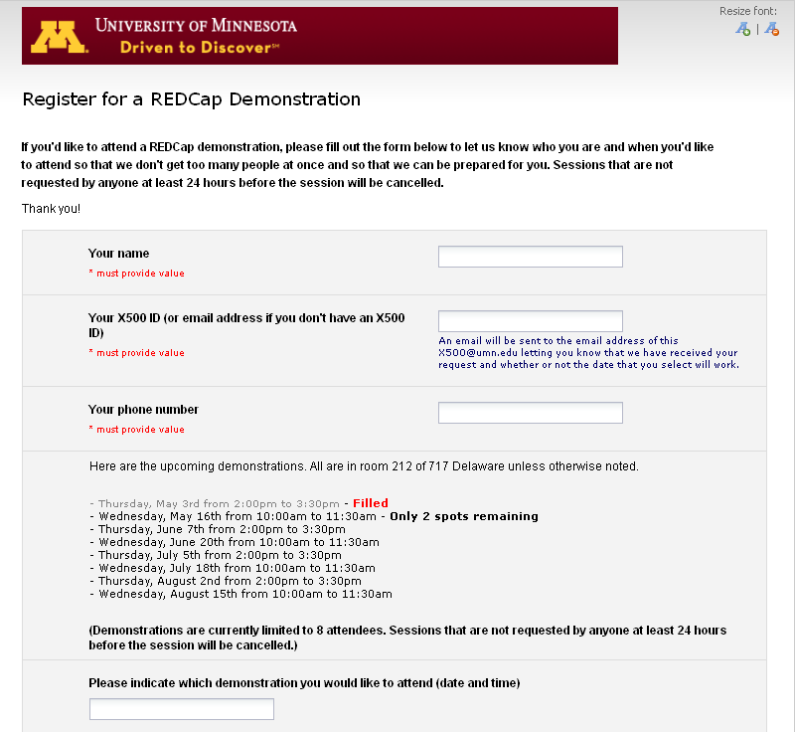

Slide 10
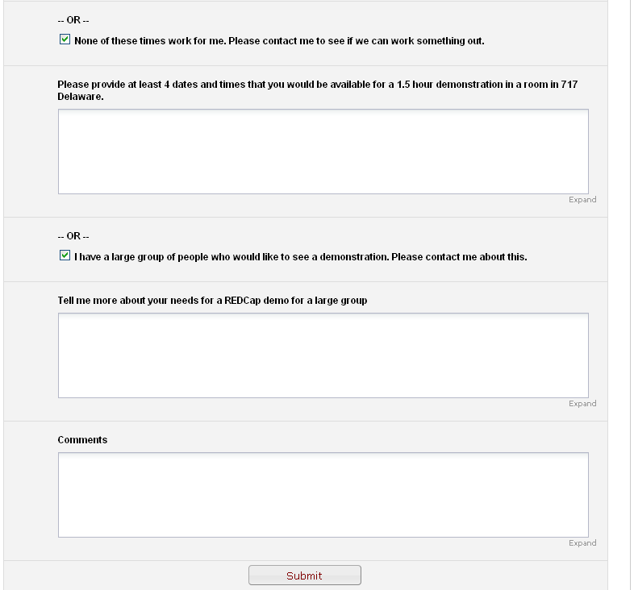

Slide 11
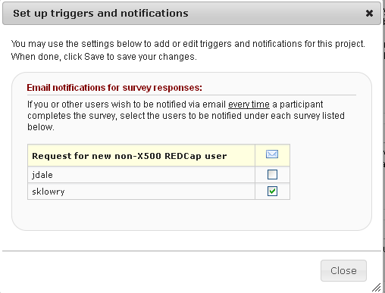
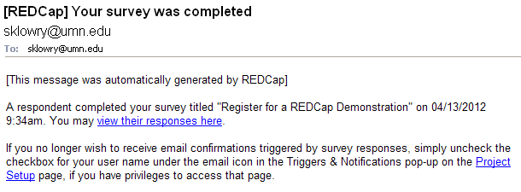

Slide 12
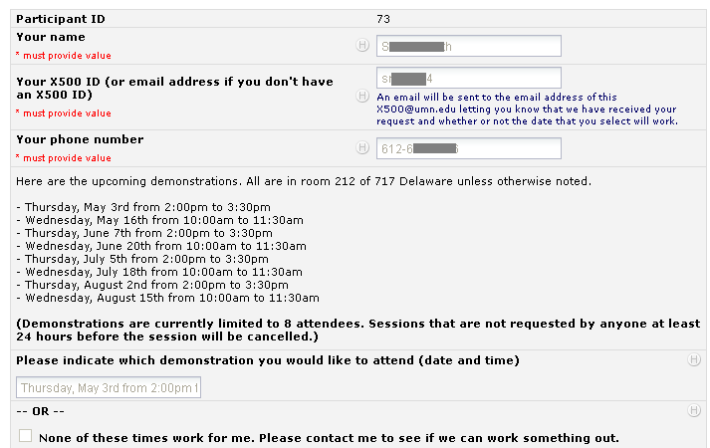

Slide 13
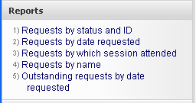
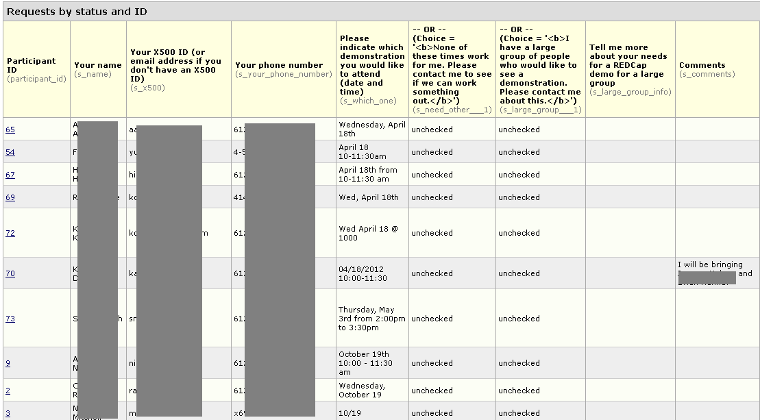
Sorted by form status and session requested so
- new registrations are at the top,
- followed by unverified (which I use until after the demo),
- and then completed.

Slide 14
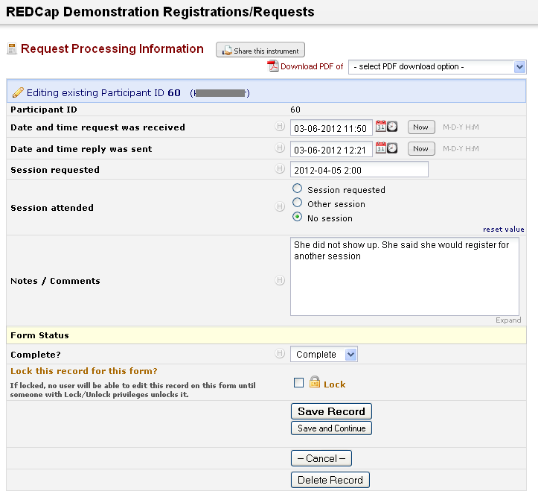

Slide 15
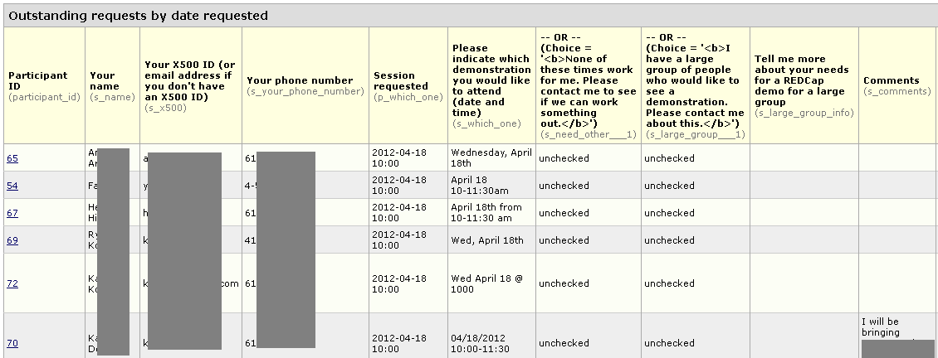
Restricted to records with form status not = completed
and sorted by session requested
so I can see the outstanding requests.

Slide 16
Request for new non-LDAP REDCap user project
Allows people to request new user setup for people on their project who don’t have a University of Minnesota account (X.500)

Slide 17
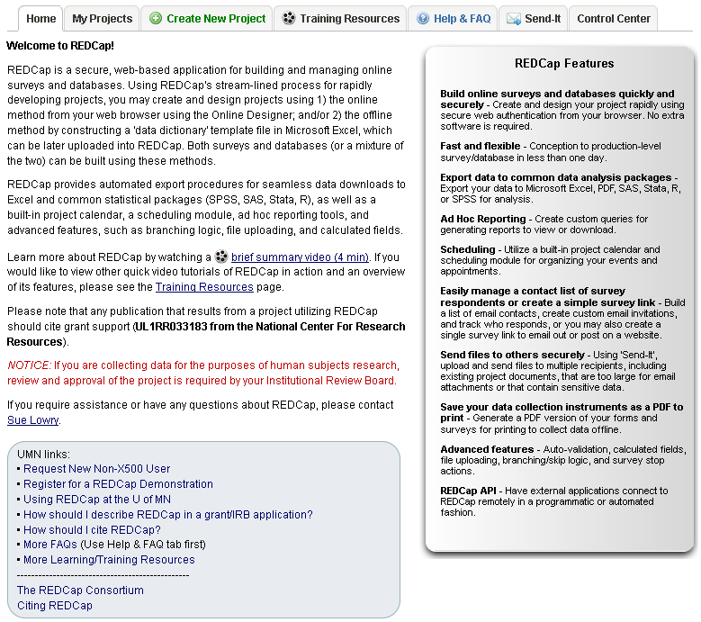


Slide 18
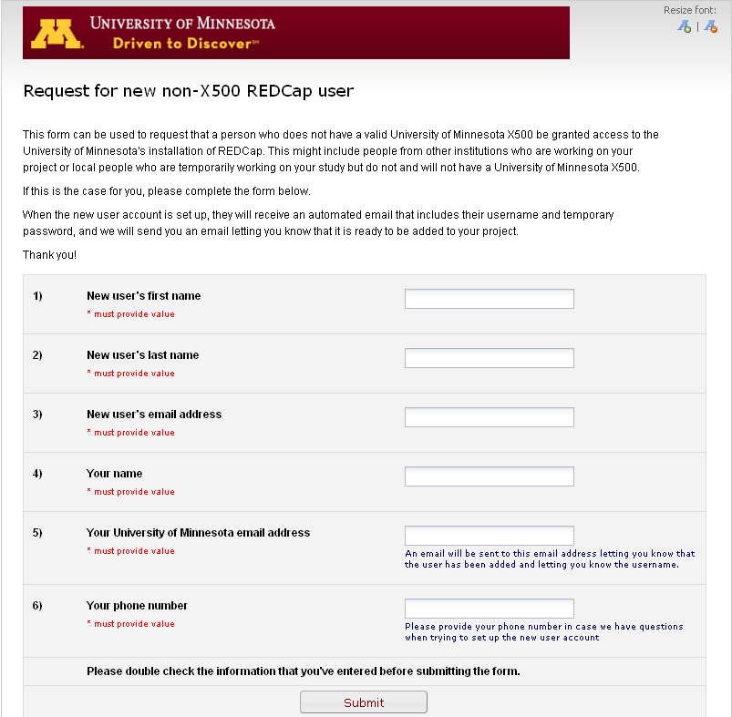

Slide 19
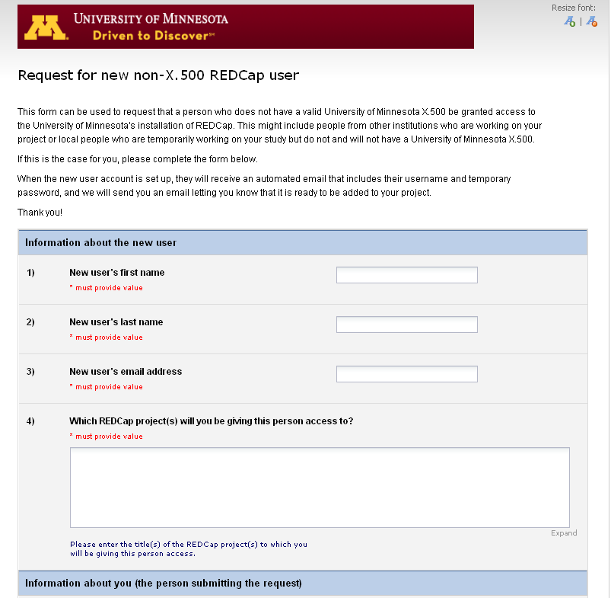

Slide 20
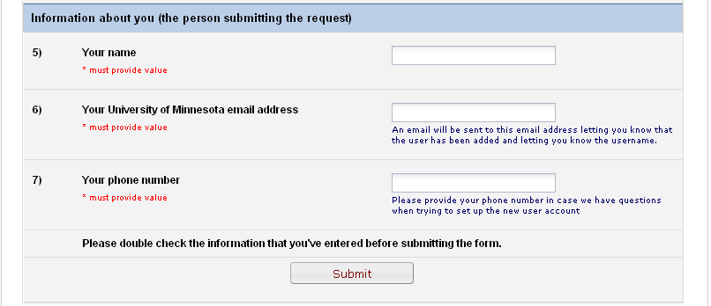

Slide 21
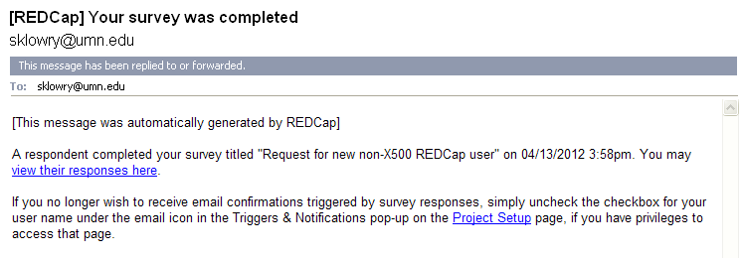

Slide 22

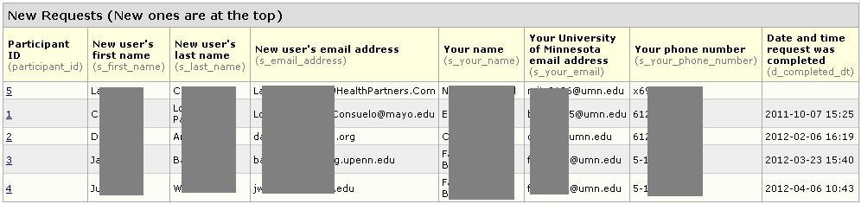

Slide 23
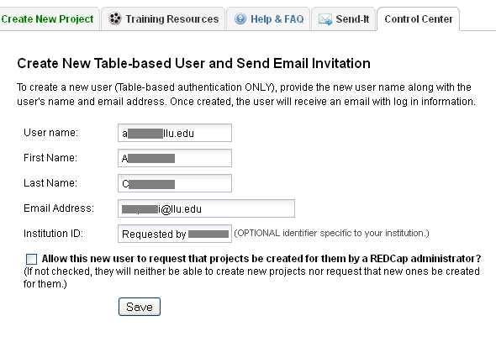
Email address with @ changed to .

Slide 24
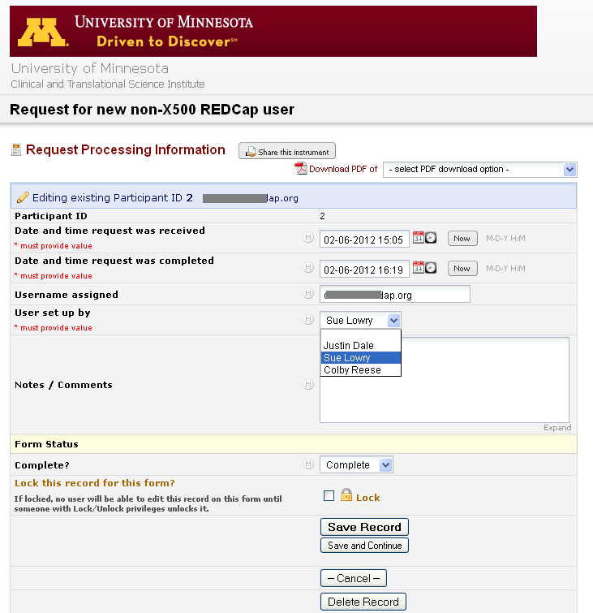

Slide 25
Links to other pages from the REDCap Home tab
Gives people one place to look for REDCap-related links

Slide 26
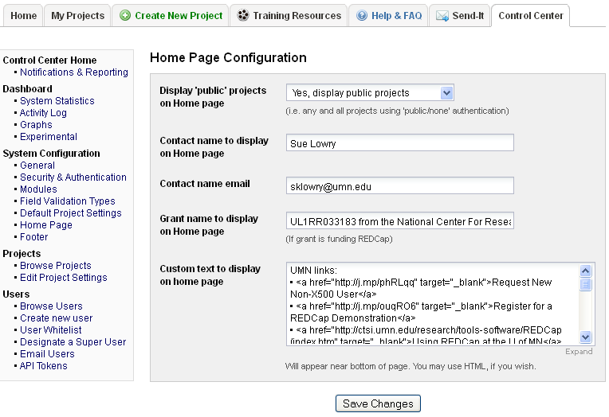

Slide 28
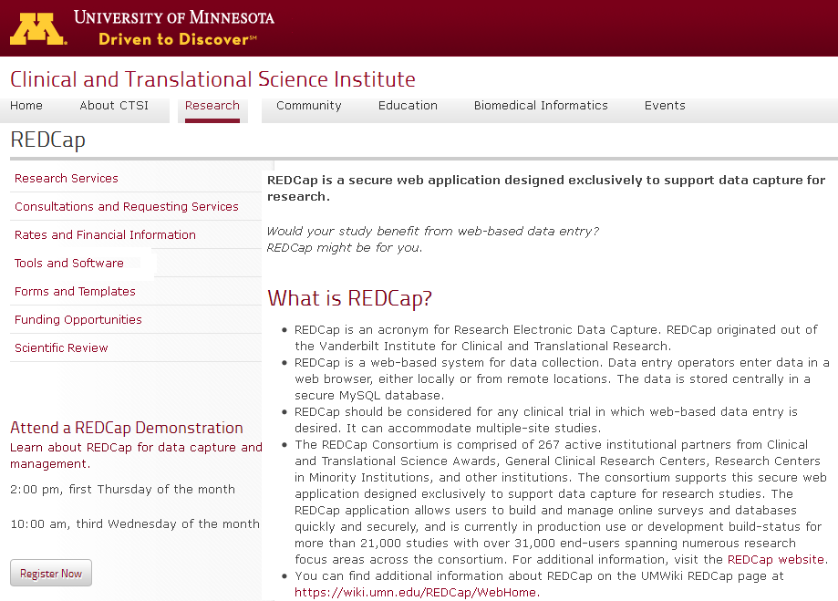

Slide 29

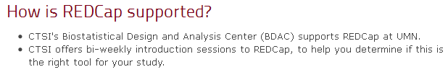

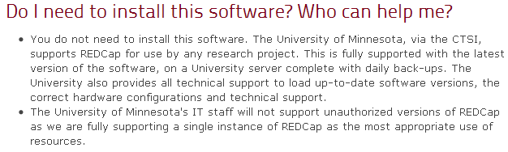
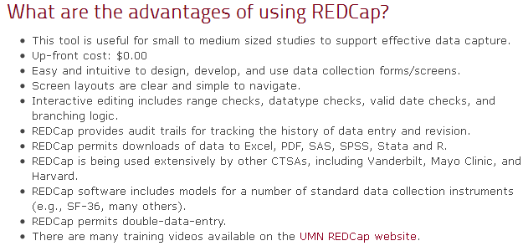
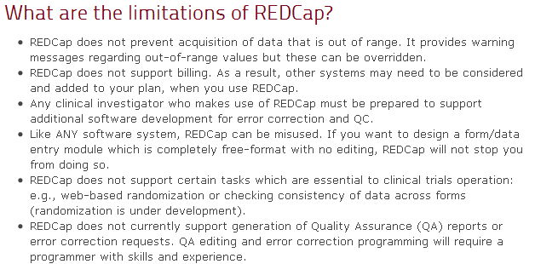
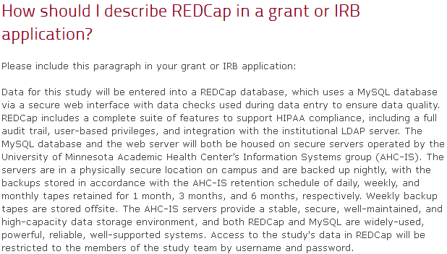
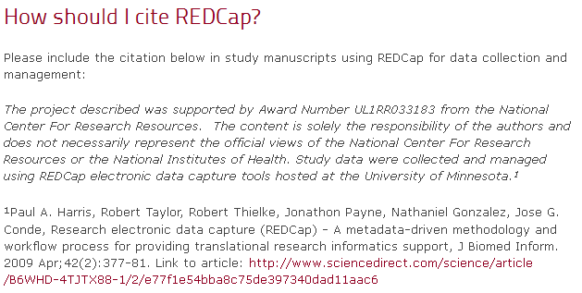

Slide 32
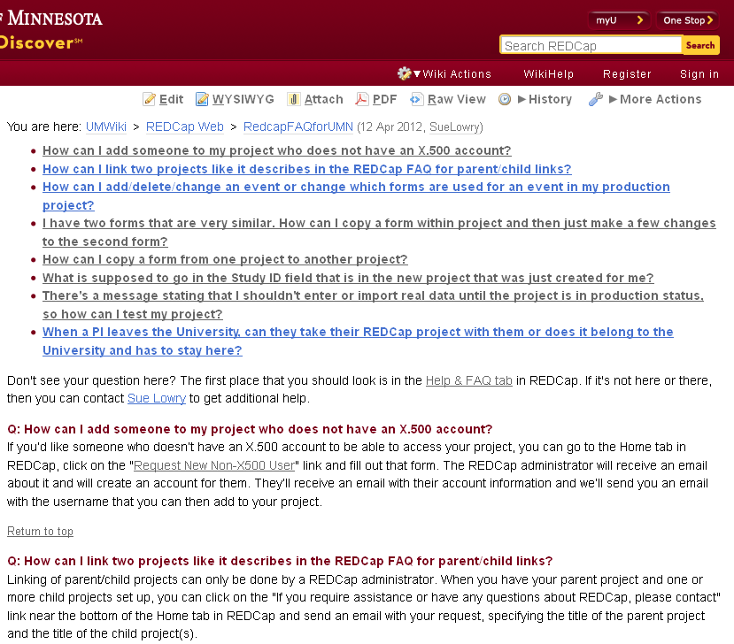

Slide 34
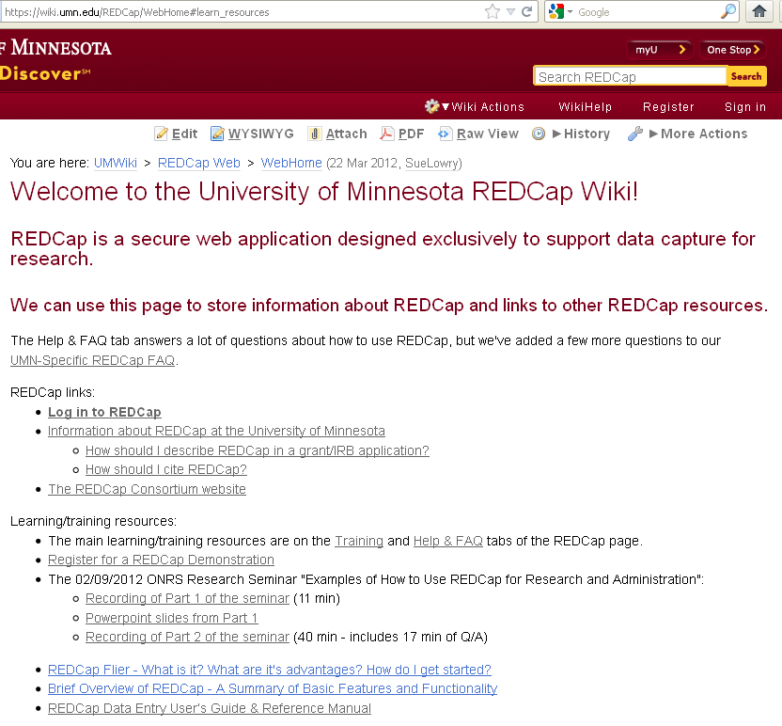

Slide 35
Thank you

